Slide 1
Kotlin
Android Developer Fundamentals

Slide 2
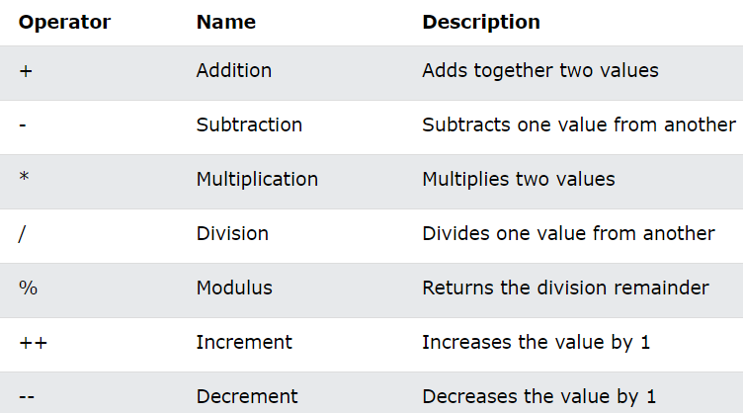
Operators

Slide 3
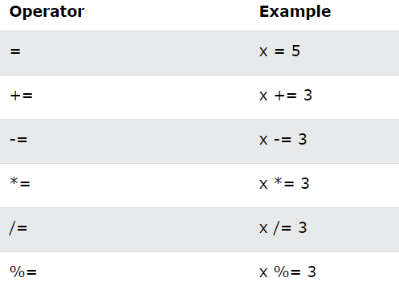
Operators

Slide 4
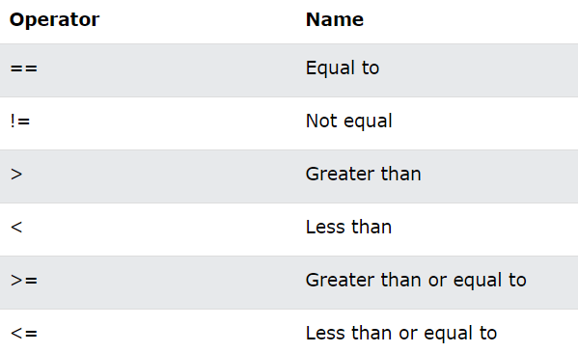
Operators

Slide 5
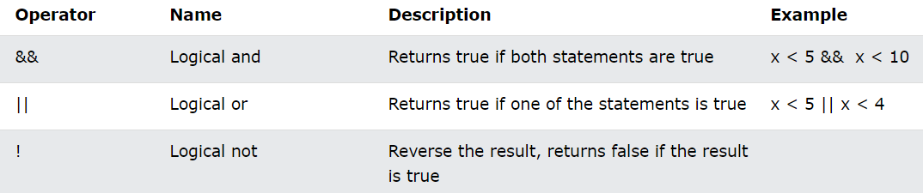
Operators

Slide 6
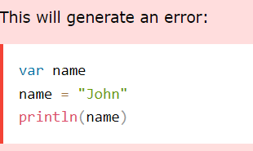

Strings
var greeting = "Hello"
var greeting: String = "Hello“
toUpperCase() toLowerCase()
txt1.compareTo(txt2)
txt.indexOf(“SomeString")
firstName + " " + lastName
firstName.plus(lastName)
"My name is $firstName $lastName"

Slide 7
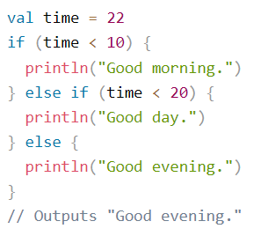
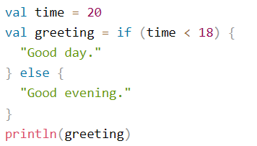
If..Else
You can ommit the curly braces {} when if has only one statement

Slide 8
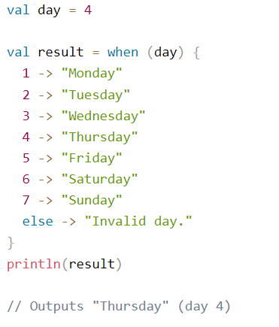
When (Switch)

Slide 9


Arrays
Arrays are used to store multiple values in a single variable, instead of creating separate variables for each value.
To create an array, use the arrayOf() function, and place the values in a comma-separated list inside

Slide 10


Ranges
You can also create ranges of values with ".."

Slide 11
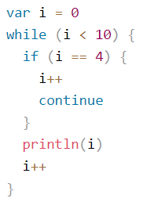
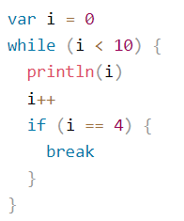
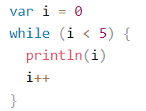
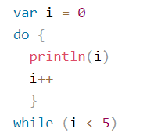
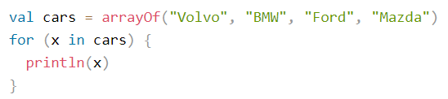
Loop

Slide 12
Learn more
https://kotlinlang.org/
Kotlin let, run, also, apply, with
Constructors
W3Schools
Google it ☺

Slide 13
END

